Slide 1
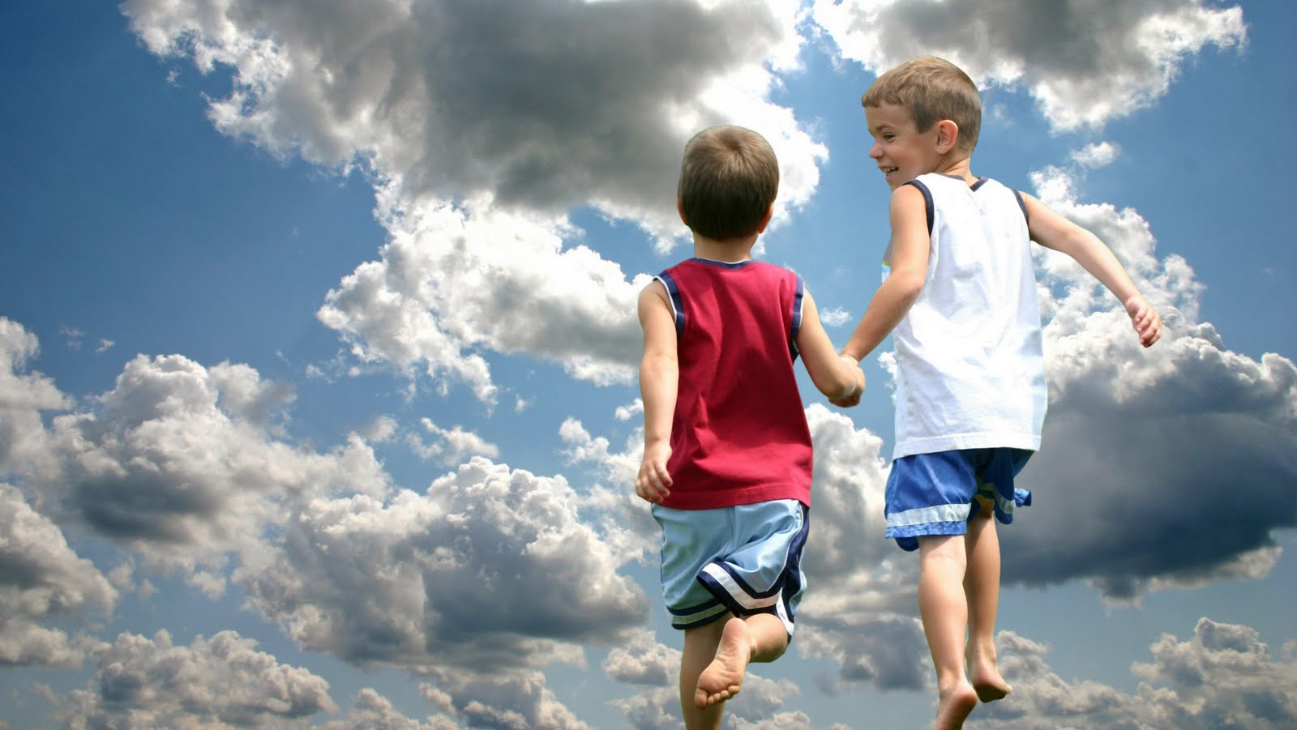
heaven & hell
Part 14: Will there be babies
& children in heaven?

Slide 2
1. Scripture regularly calls God our “Father.”
Deut 1:29-31 “Then I said to you, ‘Do not be terrified, or afraid of them. ³⁰ The Lord your God, who goes before you, He will fight for you, according to all He did for you in Egypt before your eyes, ³¹ and in the wilderness where you saw how the Lord your God carried you, as a man carries his son, in all the way that you went until you came to this place.’
Mt 6:9 In this manner, therefore, pray: our Father in heaven, hallowed be Your name.

Slide 3
2. God is of infinite compassion and will always do right.

Slide 4
Lam 3:22-23,31-32 Through the Lord’s mercies we are not consumed, because His compassions fail not. ²³ They are new every morning; great is Your faithfulness. ³¹ For the Lord will not cast off forever. ³² Though He causes grief, yet He will show compassion according to the multitude of His mercies. ³³ For He does not afflict willingly, nor grieve the children of men.
Ps 86:15 But You, O Lord, are a God full of compassion, and gracious, longsuffering and abundant in mercy and truth.
Ps 145:9 The Lord is good to all, and His tender mercies are over all His works.

Slide 5
Gen 18:25 Far be it from You to do such a thing as this, to slay the righteous with the wicked, so that the righteous should be as the wicked; far be it from You! Shall not the Judge of all the earth do right?”

Slide 6
3. Scripture makes it clear that children are special to the Lord.
(The word “children” occurs almost 100x in the Gospels alone)

Slide 7
A sparrow doesn’t fall to the ground without God knowing it.
Mt 10:29 Are not two sparrows sold for a copper coin? And not one of them falls to the ground apart from your Father’s will.

Slide 8
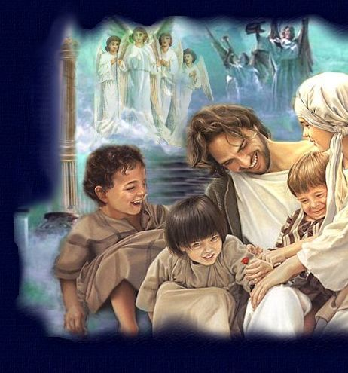
Mt 18:1-5,14 At that time the disciples came to Jesus, saying, “Who then is greatest in the kingdom of heaven?” ² Then Jesus called a little child to Him, set him in the midst of them, ³ and said, “Assuredly, I say to you, unless you are converted and become as little children, you will by no means enter the kingdom of heaven. ⁴ Therefore whoever humbles himself as this little child is the greatest in the kingdom of heaven.

Slide 9
⁴ Therefore whoever humbles himself as this little child is the greatest in the kingdom of heaven. ⁵ Whoever receives one little child like this in My name receives Me. … ¹⁴ Even so it is not the will of your Father who is in heaven that one of these little ones should perish.

Slide 10
Mt 19:13-15 Then little children were brought to Him that He might put His hands on them and pray, but the disciples rebuked them. ¹⁴ But Jesus said, “Let the little children come to Me, and do not forbid them; for of such is the kingdom of heaven.” ¹⁵ And He laid His hands on them and departed from there. (Mk 10:13-16 , Lk 18:15-16 )

Slide 11
Scripture teaches that children become human at conception
Ps 139:13-17 For You formed my inward parts; You covered me in my mother’s womb. ¹⁴ I will praise You, for I am fearfully and wonderfully made; marvelous are Your works, and that my soul knows very well. ¹⁵ My frame was not hidden from You, when I was made in secret, and skillfully wrought in the lowest parts of the earth. ¹⁶ Your eyes saw my substance, being yet unformed. and in Your book they all were written, the days fashioned for me, when as yet there were none of them. ¹⁷ How precious also are Your thoughts to me, O God! How great is the sum of them!

Slide 12
Jer 1:5 “Before I formed you in the womb I knew you; before you were born I sanctified you; I ordained you a prophet to the nations.”

Slide 13
God makes special allowances for children:
Deut 1:39 ‘Moreover your little ones and your children, who you say will be victims, who today have no knowledge of good and evil, they shall go in there; to them I will give it, and they shall possess it.

Slide 14
4. God sees children as “innocent”

Slide 15
Jer 2:34 Also on your skirts is found the blood of the lives of the poor innocents. I have not found it by secret search, but plainly on all these things.
19:4 “Because they have forsaken Me and made this an alien place, because they have burned incense in it to other gods whom neither they, their fathers, nor the kings of Judah have known, and have filled this place with the blood of the innocents

Slide 16
There is a great difference between “innocent” and “sinless”
Ps 51:5 Behold, I was brought forth in iniquity, and in sin my mother conceived me.
Rom 3:10 “There is none righteous, no, not one;

Slide 17
Everyone is born lost, but remains so by “rejecting” the Gospel
Ezk 18:20 The soul who sins shall die. The son shall not bear the guilt of the father, nor the father bear the guilt of the son. The righteousness of the righteous shall be upon himself, and the wickedness of the wicked shall be upon himself.
Rev 21:8 But the cowardly, unbelieving, abominable, murderers, sexually immoral, sorcerers, idolaters, and all liars shall have their part in the lake which burns with fire and brimstone, which is the second death.”

Slide 18
Children have no ability to choose between right and wrong
Deut 1:39 ‘Moreover your little ones and your children, who you say will be victims, who today have no knowledge of good and evil, …
Is 7:16 For before the Child shall know to refuse the evil and choose the good, the land that you dread will be forsaken by both her kings.

Slide 19
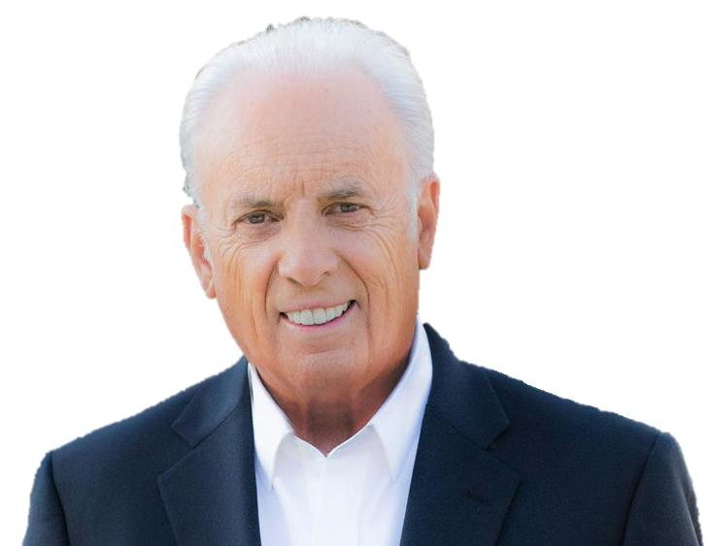
“Little children have no record of unbelief or evil works, and therefore, there is no basis for their deserving an eternity from God. … They are graciously and sovereignly saved by God as part of the atoning work of Jesus Christ.”
John MacArthur, Safe In the Arms of God

Slide 20
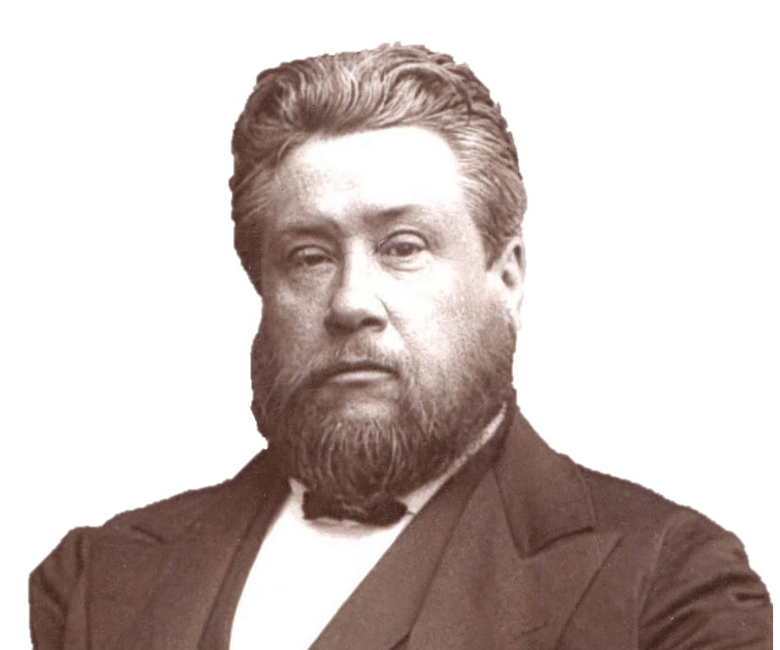
“Are [infants] saved? And if so, how? I answer, saved they are beyond a doubt; all children dying in infancy are caught away to dwell in … heaven. … But mark this – no infant was ever saved apart from the death of Christ. … they are washed from all original corruption which they had inherited from their parents, and thus washed and cleansed they enter into the kingdom of heaven. …

Slide 21
If infants were not washed in the blood of Christ, they could not join in that universal song which perpetually surrounds the throne of God. We believe that they are all saved – every one of them without exception …”
Charles Spurgeon, “The Way of Salvation”

Slide 22
“How can we be sure that an infant or child has gone to heaven since they may not have accepted Jesus Christ? Because they were too young to have chosen sin, to have reached an accountable age, to have known about sin and salvation through Jesus Christ. The saving work of Christ has reversed sin’s curse and covered this little one.”
Jim Henry, Baptist pastor, A Minister’s Treasury of Funeral & Memorial Messages

Slide 23
“Babies cannot understand the witness of God, either in creation or in the Scripture. They cannot yet comprehend the truth of the Gospel. Yet God loves them deeply. He loves children and He delights in the babies He has created. He loves the preborn and He loves the newborn. He loves the infant and He loves the toddler.”
David Jeremiah, Revealing the Mysteries of Heaven

Slide 24
5. Children go to heaven immediately upon death

Slide 25
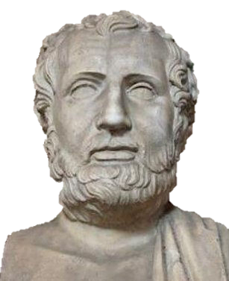
Explaining the beliefs of Christians to Roman Emperor Hadrian in A.D. 125:
“If any righteous person of their number passes away from the world, they rejoice and thank God, and escort his body as if he were setting out from one place to another nearby. When a child is born to one of them, they praise God. If it dies in infancy, they thank God the more, as for one who has passed through the world without sins.”
Marcianus Aristides
early Christian apologist

Slide 26
King David’s child:
2 Sam 12:15-23 I shall go to him, but he shall not return to me.”

Slide 27
6. Quite possibly, the largest number of people in heaven will be those who died as children
66% of all conceived in the womb never survive to see a fifth year of life.
Most receive Jesus between the ages of 5 and 15.

Slide 28
7. Does Scripture give an “age of accountability?”
Lk 2:41-50 (Jesus is 12)
Polycarp came to Christ at the age of 9

Slide 29
8. How old will children be in heaven?

Slide 30
Randy Alcorn

Slide 31
“Is it possible that children, after they’re resurrected on the new earth, will be at the same level of development as when they died? If so, these children would presumably be allowed to grow up on the new earth – a childhood that would be enviable, to say the least! Believing parents, then, would presumably be able to see their children grow up – and likely have a major role in their lives as they do so. … Although it’s not directly stated and I am therefore speculating, it’s possible that parents whose hearts were broken through the death of their children will not only be reunited with them but will also experience the joy of seeing them grow up – in a perfect world.”

Slide 32
Mk 5:39 When He came in, He said to them, “Why make this commotion and weep? The child is not dead, but sleeping.”

Slide 33
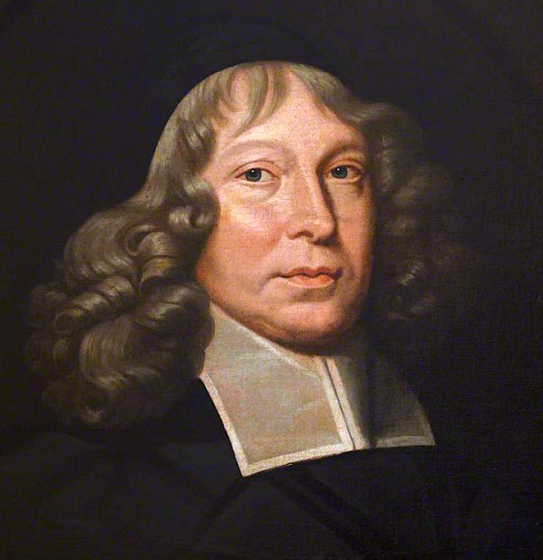
“Ye have lost a child – nay, she is not lost to you, who is found to Christ; she is not sent away, but sent before; like unto a star, which going out of our sight, doth not die and vanish, but shineth in another atmosphere.”
Samuel Rutherford, Scottish theologian

